Slide 1

Chapter 4 Simple Sorting

Slide 2

Outline
How Would You Do It?
Bubble Sort
Selection Sort
Insertion Sort
Sorting Objects
Comparing the Simple Sorts

Slide 3

Reasons to sort
Because it is so important and potentially so timeconsuming,
Need to sort data by different fields.
A preliminary step to searching data.
Sorting has been the subject of extensive research in computer science, and some very sophisticated (精巧的)method have been developed.
Inventor of QuickSort (快速排序)
1980年度图灵奖的英国牛津大学计算机科学家查尔斯·霍尔(Charles Antony Richard Hoare)。
carh@comlab.ox.ac.uk

Slide 4
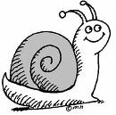
What we will discuss
Bubble Sort(冒泡排序)
Selection Sort（选择排序）
Insertion Sort（插入排序）
Unsophisticated（不精巧）
Comparatively slow
But they are
Easier to understand（更易于理解）
Actually better in some circumstances
（在某些情形表现更佳）

Slide 5

How Would You Do It?
You want to arrange the players in order of increasing height.
How would you go about this sorting process?

Slide 6
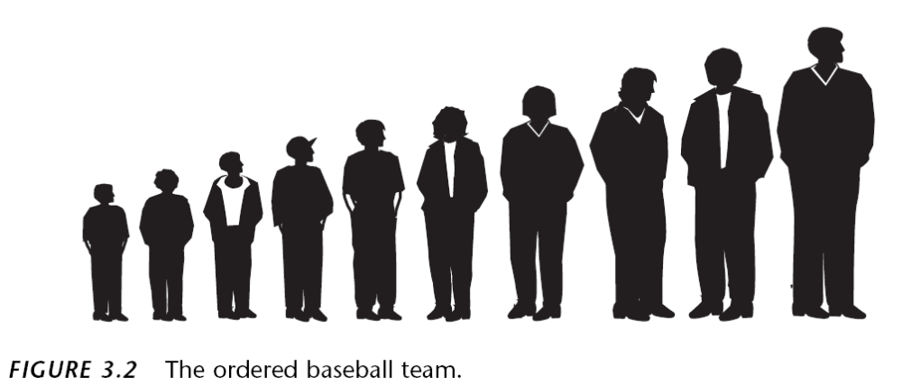
How Would You Do It?
You can see all the kids at once, so you would have no trouble in lining up all the kids.
But a computer can’t…..

Slide 7

How Would You Do It?
A computer program can compare only two players at one time
To design a sorting algorithm, we must concentrate on the details and follow some simple rules(简单的规则).
The three algorithms in this chapter all involve two steps, executed over and over until the data is sorted:
1. Compare two items.
2. Swap two items, or copy one item.
Each algorithm handles the details in a different way.

Slide 8

Bubble Sort
Notoriously slow, but conceptually the simplest
臭名昭著的慢，但在概念上是最简单的….
Bubble Sort on the Baseball Players
Imagine that you can see only two of the baseball players at the same time, how would you sort them?

Slide 9
Bubble Sort
You start at comparing the two kids in positions 0 and 1.
If the one on the left (in 0) is taller, you swap them.
If the one on the right is taller, you don’t do anything.
Then you move over one position and compare the kids in positions 1 and 2.
Again, if the one on the left is taller, you swap them.

Slide 10
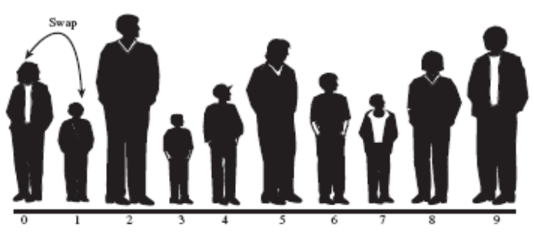




Bubble Sort
Continue down the line this way until reach the right end. The tallest kid is on the right.
The biggest items “bubble
up” to the top end of the array.

Slide 11










0 | 1 | 2 | 3 | 4 | 5 | 6 | 7 | 8 | 9
STEP 1:从0开始，两两比较，if 左边高过右边，交换位置；else do nothing。
STEP 2:往右边移动一位，重复STEP1直至？

Slide 12

Bubble Sort
How many comparisons and swaps happened after the first round?
N-1 comparisons and between 0 and N-1 swaps.
Start from here again
unsorted
You continue this process until all the players are in order.

Slide 13
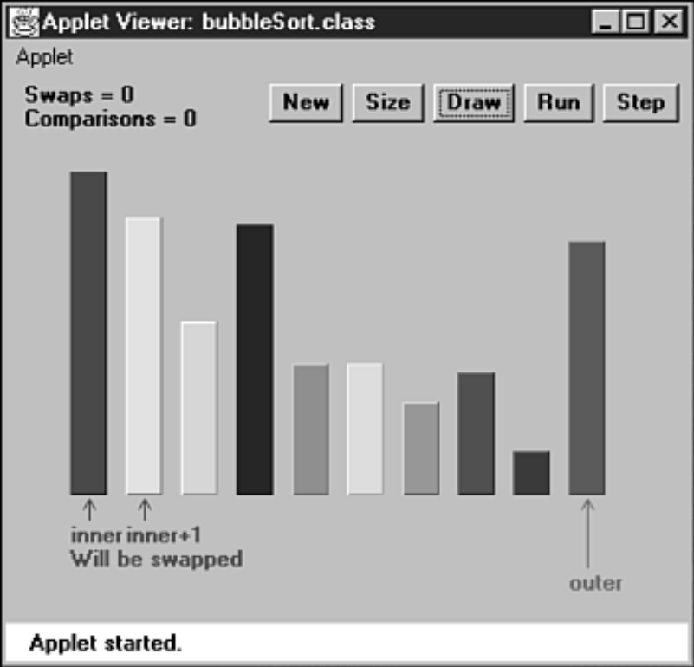
Bubble Sort
The BubbleSort Workshop Applet

Slide 14
Bubble Sort
In the program, a class called ArrayBub encapsulates(封装) an array a[], which holds variables of type long.
在一些实际的程序中，数组元素的类型通常不是Primitive Type，而是对象。此处采用long是为了简单起见。另外程序中还略掉了find，delete函数。

Slide 15
Bubble Sort
The constructor and the insert() and display() methods of this class are similar to those we’ve seen before.
However, there’s a new method: bubbleSort(). When this method is invoked （调用）from main(), the contents of the array are rearranged （重排）into sorted order.

Slide 16

Bubble Sort
讨论1：如何实现第一轮的冒泡？
  思路提示---从具体到抽象，用for…
讨论2：如何实现N轮的冒泡？
  思路提示：
  每轮冒泡的相同在哪里，不同在哪里？不同的地方能否用有规律变化的变量表示？可以抽象为一个什么函数？
Notes:
void bubbleOneRound(int out) {
for (int in = 0; in < out; in++){
// inner loop (forward)
if (a[in] > a[in + 1]) // out of order?
swap(in, in + 1); // swap them
}
}
public void bubbleSort() {
for (int out = nElems - 1; out > 1; out--)
bubbleOneRound(out);
}

Slide 17
Bubble Sort
bubbleSort Method
public void bubbleSort()
{
for(int out=nElems-1; out>1; out--) // outer loop (backward)
for(int in =0; in<out; in++) // inner loop (forward)
if( a[in] > a[in+1] ) // out of order?
swap(in, in+1); // swap them
} // end bubbleSort()
The out variable moves left after each pass by in so that items that are already sorted are no longer involved in the algorithm.

Slide 18
Bubble Sort
Invariants(不变量)
在许多算法中，有些量在算法进行过程中保持不变。 这些量称为“不变量”。识别这些不变量非常有助于理解算法。在某些情况下，我们可以通过检查这些不变量来调试算法。
In the bubbleSort.java program, the invariant is that the data items to the right of out are sorted. This remains true throughout the running of the algorithm. (On the first pass, nothing has been sorted yet, and there are no items to the right of out because it starts on the rightmost element.)

Slide 19
Bubble Sort
Efficiency of the Bubble Sort
1.The BubbleSort Workshop applet with 10 bars
9 comparisons on the first pass, 8 on the second, and so on, down to 1 comparison on the last pass.
For 10 items, this is 9 + 8 + 7 + 6 + 5 + 4 + 3 + 2 + 1 = 45
2.In general
Where N is the number of items in the array, there are N-1 comparisons on the first pass, N-2 on the second, and so on.
The formula for the sum of such a series is
(N–1) + (N–2) + (N–3) + ... + 1 = N*(N–1)/2
N*(N–1)/2 is 45 (10*9/2) when N is 10.
Both swaps and comparisons are proportional to O(N²)

Slide 20
Selection Sort
Selcection Sort .vs. Bubble Sort
The number of swaps: O(N²) → O(N).
The number of comparisons remains O(N²).

Slide 21

Selection Sort
Selection Sort on the Baseball Players
You can use a notebook to remember a certain member’s height.
And a towel to mark the shortest one in the unsorted players
Brief Description
1. A pass through all the players and selecting the shortest one.
2.This shortest player is then swapped with the player on the left end of the line, at position 0.
3.The next time you pass down the row of players, you start at position 1, finding the minimum, swap with position 1.
4.This process continues until all the players are sorted.

Slide 22
Selection Sort
A More Detailed Description
Start at the left end of the line of players. Record the leftmost player’s height in your notebook and throw the magenta towel （毛巾）on the ground in front of this person.
Then compare the height of the next player to the right with the height in your notebook.
If this player is shorter, cross out the height of the first player and record the second player’s height instead. Also move the towel, placing it in front of this new “shortest” (for the time being) player.
Continue down the row, comparing each player with the minimum.
Change the minimum value in your notebook and move the towel whenever you find a shorter player.
When you’re done, the magenta towel will be in front of the shortest player.

Slide 23
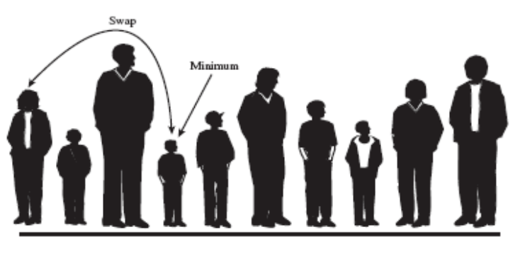
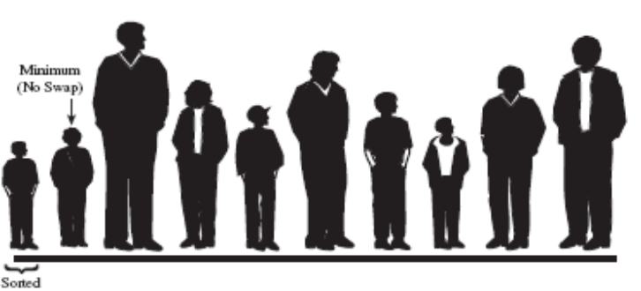
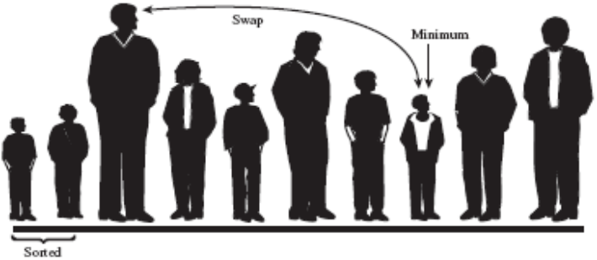
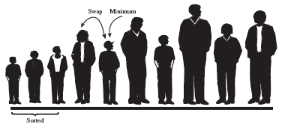
Selection Sort
The first three passes

Slide 24
200
190
180
170
175
165
160
155
150
140
0 | 1 | 2 | 3 | 4 | 5 | 6 | 7 | 8 | 9
毛巾
记事本：用于记录当前最矮的人的身高
150

Slide 25
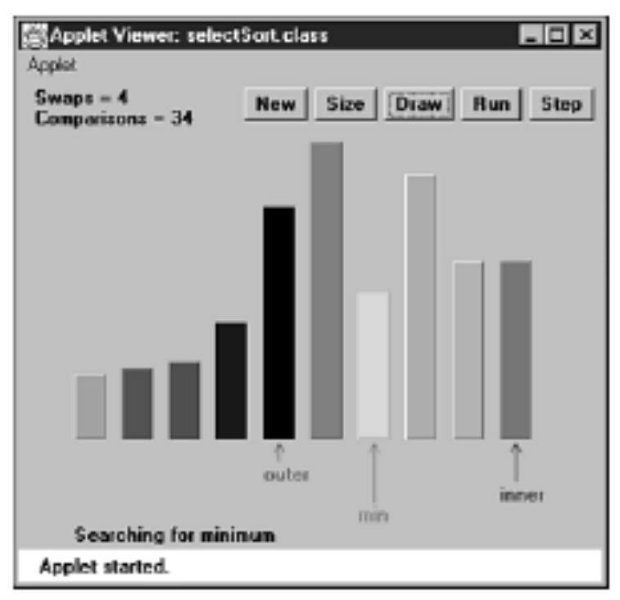
Selection Sort
The SelectSort Workshop Applet

Slide 26
Selection Sort
讨论1：如何实现第一轮的选择？
  思路提示---从具体到抽象，用for…
讨论2：如何实现N轮的选择？
  思路提示：
  每轮的相同在哪里，不同在哪里？不同的地方能否用有规律变化的变量表示？可以抽象为一个什么函数？

Slide 27
Bubble Sort
int out, in, min;
for(out=0; out<nElems-1; out++){ // outer loop
min = out; // minimum
for(in=out+1; in<nElems; in++) // inner loop
if(a[in] < a[min] ) // if min greater,
min = in; // we have a new min
swap(out, min); // swap them
} // end for(out)

Slide 28
Selection Sort
Java Code for Selection Sort
Similar to that for bubbleSort.java,
except that
ArraySel → ArrayBub
bubbleSort() →selectSort().

Slide 29
Selection Sort
Invariant
The data items with indices ≤ out(程序中的变量) are always sorted.
Efficiency
The selection sort performs the same number of comparisons as the bubble sort: N*(N-1)/2.
For large values of N, the comparison times will dominate, so we would have to say that the selection sort runs in O(N²) time.
However, it is unquestionably faster because there are so few swaps.

Slide 30
Insertion Sort
It still executes in O(N²) time, but it’s about twice as fast as the bubble sort and somewhat faster than the selection sort in normal situations.
It’s often used as the final stage (后期)of more sophisticated sorts, such as Quicksort.

Slide 31

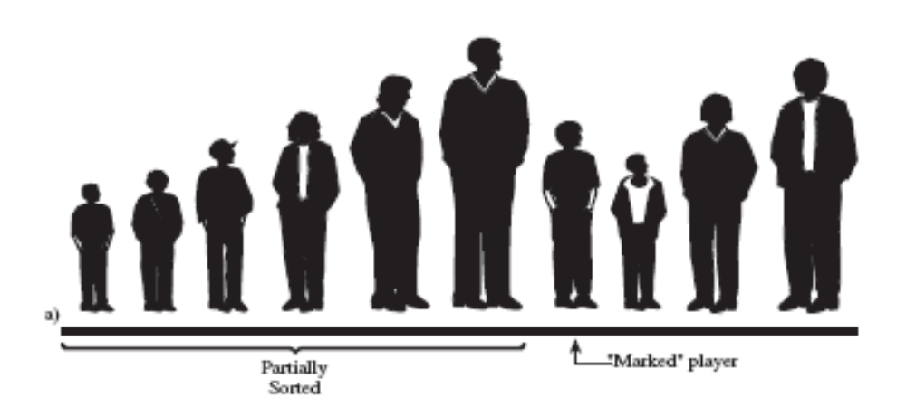
Insertion Sort
Insertion Sort on the Baseball Players
Partial Sorting
Insert the marked player in
the appropriate place in the
(partially) sorted group.
The Marked Player

Slide 32
Insertion Sort
How to insert the marked player in the appropriate place in the (partially) sorted group?
Shift some of the sorted players to the right to make room.（将部分有序的选手往右移动，以腾出空间）
To provide a space for this shift, we take the marked player out of line.

Slide 33
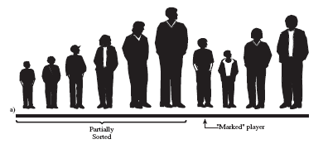
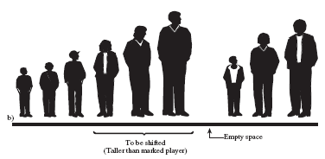
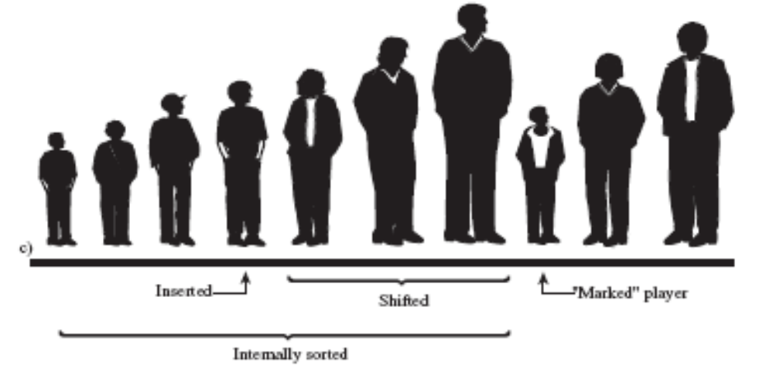
Insertion Sort
The insertion sort on baseball players.

Slide 34
200
200
190
180
170
175
165
160
155
140
150
0 | 1 | 2 | 3 | 4 | 5 | 6 | 7 | 8 | 9
Marked Player

Slide 35
Insertion Sort
When does this shifting process stop?(什么时候停止向左搜索?)
When you’ve shifted the last player that’s taller than the marked player.
What’s next?
Now the partially sorted group is one player bigger, and the unsorted group is one player smaller. The marker T-shirt is moved one space to the right, so it’s again in front of the leftmost （最左）unsorted player.
Now the partially sorted group is one player bigger, and the unsorted group is one player smaller. The marker T-shirt is moved one space to the right, so it’s again in front of the leftmost （最左）unsorted player.
This process is repeated until all the unsorted players have been inserted (hence the name insertion sort) into the appropriate place in the partially sorted group.
This process is repeated until all the unsorted players have been inserted (hence the name insertion sort) into the appropriate place in the partially sorted group.

Slide 36
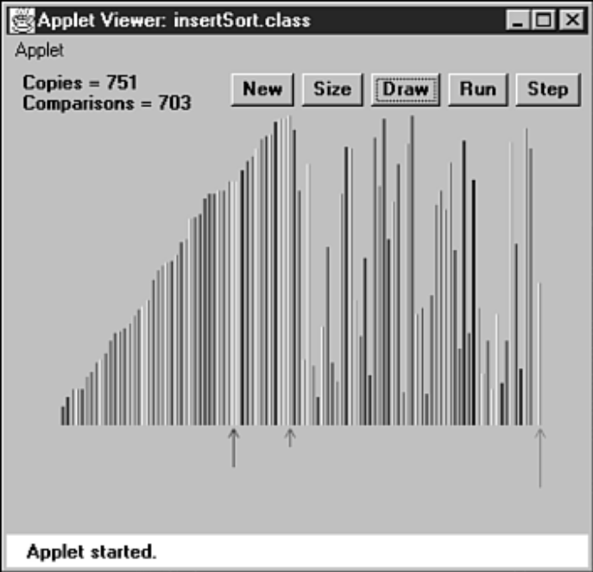
Insertion Sort
The InsertSort Workshop Applet

Slide 37
Insertion Sort
讨论1：如何实现第i轮的插入？
  思路提示---从具体到抽象，用while…
讨论2：如何实现N轮的插入？
  思路提示：
  每轮的相同在哪里，不同在哪里？不同的地方能否用有规律变化的变量表示？可以抽象为一个什么函数？

Slide 38
Insertion Sort
Java Code for Insertion Sort
for(int out=1; out<nElems; out++) {// out is dividing line
long temp = a[out]; // remove marked item
int in = out; // start shifts at out
while(in>0 && a[in-1] >= temp) {// until one is smaller
a[in] = a[in-1]; // shift item
--in ; // go left one position
}
a[in] = temp; // insert marked item
} // end for

Slide 39
Insertion Sort
The insertSort.java Program
Invariants
At the end of each pass, following the insertion of the item from temp, the data items with smaller indices than outer are partially sorted.

Slide 40
Insertion Sort
Efficiency
How many comparisons and copies does this algorithm require?
On the first pass, it compares a maximum of one item. On the second pass, it’s a maximum of two items, and so on, up to a maximum of N-1 comparisons on the last pass.
This is 1 + 2 + 3 + … + N-1 = N*(N-1)/2
On the first pass, it compares a maximum of one item. On the second pass, it’s a maximum of two items, and so on, up to a maximum of N-1 comparisons on the last pass.
This is 1 + 2 + 3 + … + N-1 = N*(N-1)/2
The number of copies ≈ The number of comparisons.
The number of copies ≈ The number of comparisons.
the insertion sort runs in O(N²) time for random data.
the insertion sort runs in O(N²) time for random data.
Discussion
Data that is already sorted
Data arranged in inverse （相反的）sorted order

Slide 41
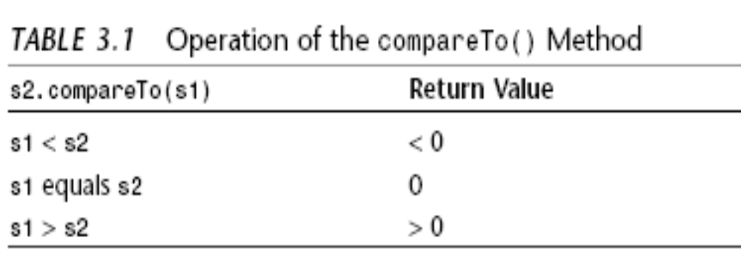
Sorting Objects
Java Code for Sorting Objects
Lexicographical Comparisons（字典次序比较）
Research Work：
对汉字进行排序？

Slide 42
Sorting Objects
Stability(稳定性)
When data items that have equal keys.
You want the algorithm to sort only what needs to be sorted, and leave everything else in its original order.
Some sorting algorithms retain this secondary ordering; they’re said to be stable.
All the algorithms in this chapter are stable.

Slide 43
Comparing the Simple Sorts
There’s probably no point in using the bubble sort, unless you don’t have your algorithm book handy. The bubble sort is so simple that you can write it from memory.
Bubble sort
Minimizes the number of swaps, but the number of comparisons is still high.
Selection sort
The most versatile of the three
The best bet in most situations
Insertion sort
Memory space that it needs
All three of the algorithms in this chapter carry out their sort in place（在原来位置）, meaning that, besides the initial array, very little extra memory is required.

Slide 44

Summary
本章的排序算法都以Array为数据存储结构。
排序包括比较数组中数据项的关键字和移动相应的数据项(实际上，是数据项的引用)，直到它们排好序为止。
本章所有算法的时间复杂度都是O(N²)。不过，某些情况下某个算法可以比其他算法快很多。
不变性是指在算法运行时保持不变的条件。
冒抱排序算法是效率最差的算法，但它最简单。
插入排序算法是本章介绍的O(N²)排序算法中应用最多的。
如果具有相同关键字的数据项，经过排序它们的顺序保持不变，这样的排序就是稳定的（Stable）。
本章介绍的所有排序算法除了需要初始数组之外，都只需要一个临时变量。

Slide 45
Experiment
1.修改bubbleSort.java(Listing-3.1)中的main()方法，新建一个大数组并给数组赋值。可以用下面的代码产生随机数:
for(int j=0; j<maxSize; j++) // fill array with
{ // random numbers
long n = (long)( java.lang.Math.random()*(maxSize-1) );
arr.insert(n);
}
试插入10000个数据项。在排序前和排序后分别显示这些数据。滚屏显示将花费很长的时间。把display{)方法注释掉就可以看出排序本身花了多少时间。在不同的机器上时间是不同的。为100000个数据排序可能不到30秒钟。选择一个数组的容量，排序并计时。然后用同样的数组容量对selectSort.java(Listing-3.1)和insertSort.java(Listing-3.3)计时。观察这三种排序算法的速度的不同。
2.在bubbleSort.java中设计代码使得输入的数据呈逆序(99999 99998 99997……)。用和实验1中同样数量的数据，观察排序运行的快慢，用selectSort.java和insertSort.java重复这个实验。
3.在bubbleSort.java中设计代码使得输入的数据为有序(0,1,2,3,…)。用实验1和实验2相比，观察排序运行的快慢，用selectSort.java和insertSort.java重复这个实验。

Slide 46

The End
大数据时代
http://www.bilibili.tv/video/av614728/

